Slide 1

Applied Data Science Portfolio Milestone
School of Information Sciences
Rohini Shrivastava
September 1, 2021
M.S. in Applied Data Science

Slide 2
WHAT IS DATA SCIENCE
Uses various scientific methods, processes, and algorithms to get information
Structured and unstructured data
Artificial Intelligence, Machine Learning and Deep learning
Used to refine their goods and services.

Slide 3
GOALS
Describe a broad overview of the major practice areas in data science.
Collect and organize data.
Identify patterns in data via visualization, statistical analysis, and data mining.
Develop alternative strategies based on the data.
Develop a plan of action to implement the business decisions derived from the analyses.
Demonstrate communication skills regarding data and its analysis for managers, IT professionals, programmers, statisticians, and other relevant professionals in their organization.
Synthesize the ethical dimensions of data science practice (e.g., privacy).

Slide 4

IST652 -SCRIPTING FOR DATA ANALYSIS

Slide 5

IST652 – SCRIPTING FOR DATA ANALYSIS
The word ‘happiness’ is used to categorize the mental states of a person
It is related to positive emotions like contentment to euphoria
Used World Happiness Report/Twitter
What factors contribute to happiness and how covid affected it

Slide 6
IST652 – SCRIPTING FOR DATA ANALYSIS
Project Goals
Who is the happiest? Who is the least happy?
What is the strongest variable on happiness? What is the least influential variable?
How has COVID impacted the variables associated with happiness?
What are people’s overall sentiment in regards to COVID? What about the report itself?
How have people’s feelings changed between 2019 and 2021?

Slide 7
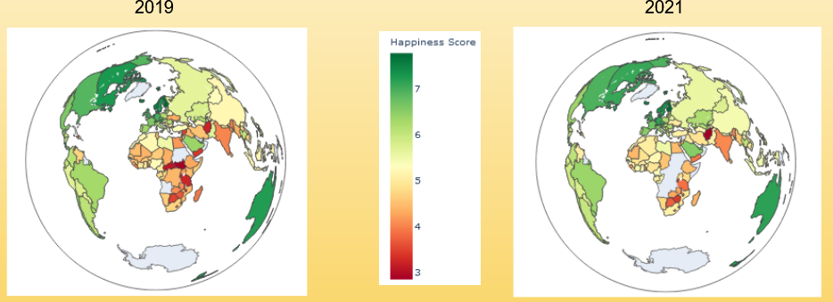
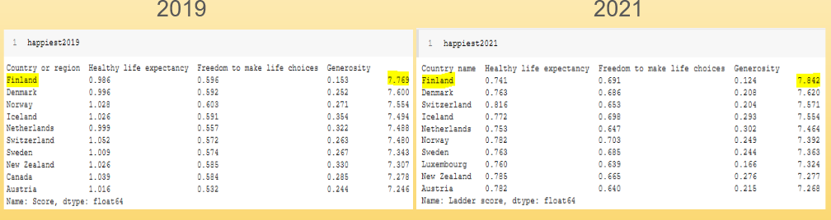
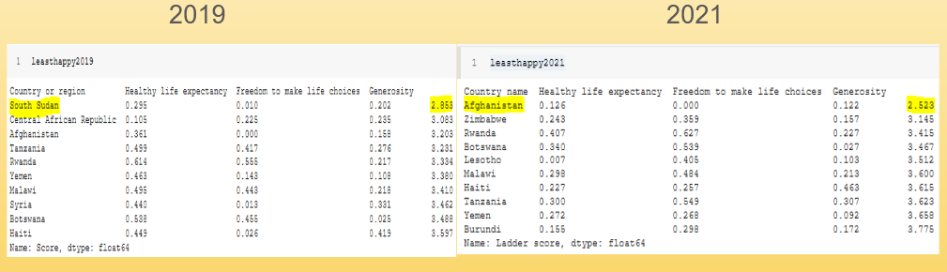
IST652 – SCRIPTING FOR DATA ANALYSIS
Project Goals

Slide 8
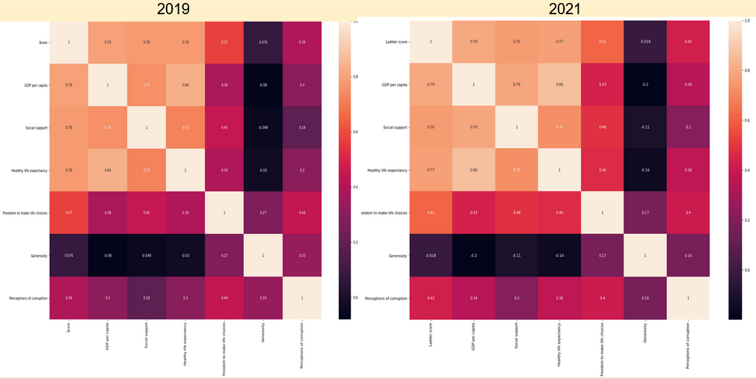
IST652 – SCRIPTING FOR DATA ANALYSIS

Slide 9
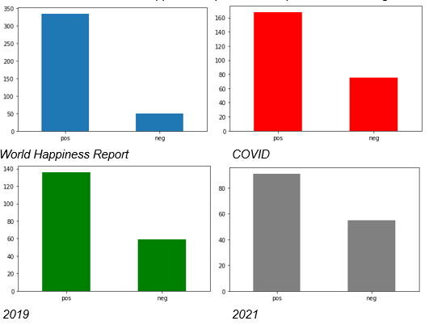
IST652 – SCRIPTING FOR DATA ANALYSIS

Slide 10
IST652 – SCRIPTING FOR DATA ANALYSIS
See the trends in countries and how happiness changed over time
Correlation between see the correlation between each of the variables
GDP, Social Support, Life Expectancy, Freedom to Make Life Choices, and Perceptions of Corruption
What contributes to happiness
Leaders need to focus on these variables for most citizens
If leaders only focus on certain aspects and ignore others it can detriment the lives of some citizens.

Slide 11

IST736 –TEXT MINING

Slide 12
IST736 – TEXT MINING
Introduces concepts and methods for knowledge discovery from large amounts of text data
Writers of all genres have similar ideas
Macabre subjects and topics of the writings and overlap is anticipated
Modeling techniques
Computer trained model to believe the work was written by someone else
Data taken from Gutenburg Project
Stoker, James, Blackwood, Poe

Slide 13
IST736 – TEXT MINING
PROJECT GOALS
Is it possible that the writing style of these four core authors influenced not only each other, but additional writers of the era?
How do the audience feel about these authors?

Slide 14
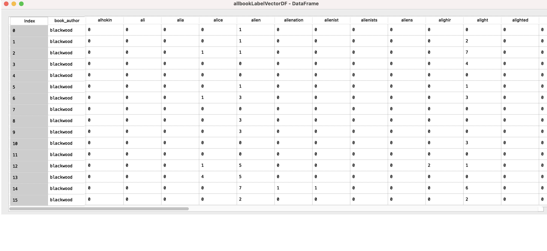
IST736 – TEXT MINING

Slide 15
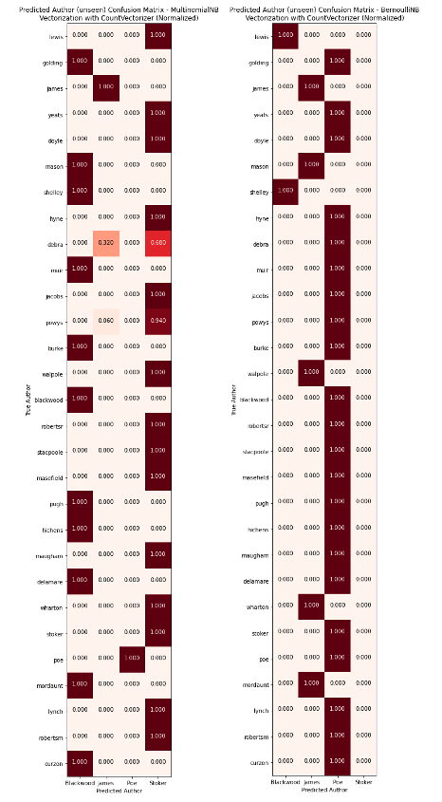
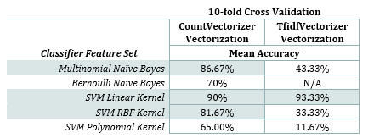
IST736 – TEXT MINING

Slide 16
IST736 – TEXT MINING

Slide 17
IST736 – TEXT MINING
Unstructured data can be transformed it into structured data
Text data collected to classify other works
Find patterns in the data by seeing most used words after the vectorization
Run sentiment on the authors works
See readers thoughts on authors
Businesses can use this kind of sentiment analysis to see how customers feel about their product through text reviews

Slide 18

IST687 –INTRODUCTION TO DATA SCIENCE

Slide 19
IST687 – INTRODUCTION TO DATA SCIENCE
Teaches students how to collect, process, transform, analyze, and communicate about data through R
Investigated video game sales to see how patterns and trends have changed over time
See what games, regions, genres have the greatest rate of return on investment
The video game industry is a very profitable business
It is projected is that over a billion people around the globe play videogames
Data taken from Kaggle

Slide 20
IST687 – INTRODUCTION TO DATA SCIENCE
Project Goals
What console released the most games overall?
What year had the most games released?
What genre of game was the highest in sales overall?
Which region has the most sales?
Which publisher published the most games?
What is the trend of global video game sales over the years?
What are the average sales per game released in a given year?
Can we create a model that predicts global sales by utilizing only one of the three regions?

Slide 21
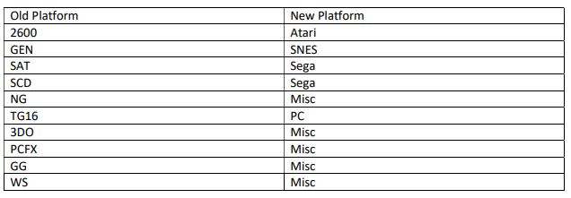
IST687 – INTRODUCTION TO DATA SCIENCE

Slide 22
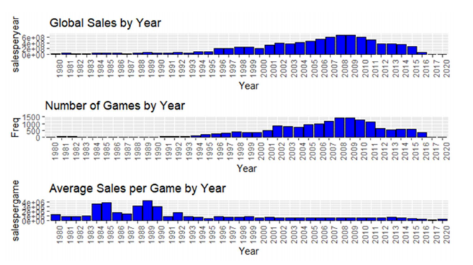
IST687 – INTRODUCTION TO DATA SCIENCE

Slide 23
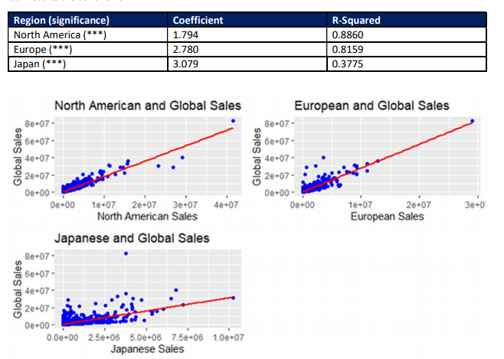
IST687 – INTRODUCTION TO DATA SCIENCE

Slide 24

IST687 – INTRODUCTION TO DATA SCIENCE
90 billion dollars as of 2020
Collecting the data from Kaggle was a good start
Saw trends in video games through out the year
Linear regression showed how global sales are affected
Where to market their game more
What can cater to the market

Slide 25
CONCLUSION
Data is everywhere means that it is important to fully understand how it works
Syracuse University’s M.S. in Applied Data Science program teaches it’s students different aspects of Data Science
Organize, identify patterns, make business decisions, and understand the ethics behind data
The data science field has grown tremendously
Through this program I was able to be learn and grow my abilities to be a better Data Scientist.

Slide 26

THANK YOU!
School of Information Sciences
Rohini Shrivastava
September 1, 2021
M.S. in Applied Data Science

